Slide 1

Types Of Cyber Attack
Webinar

Slide 2
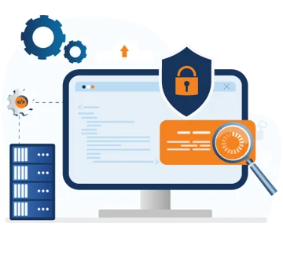
Intro To CyberSecurity

Slide 3

What Is Cyber Security
Cyber security is the practice of protecting systems, networks, and data from unauthorized access, use, disclosure, disruption, modification, or destruction.
Now days our businesses are online over the internet. Cyber attackers trying to attack growing businesses for personal gain. That type of hacker called Black hat hackers

Slide 4
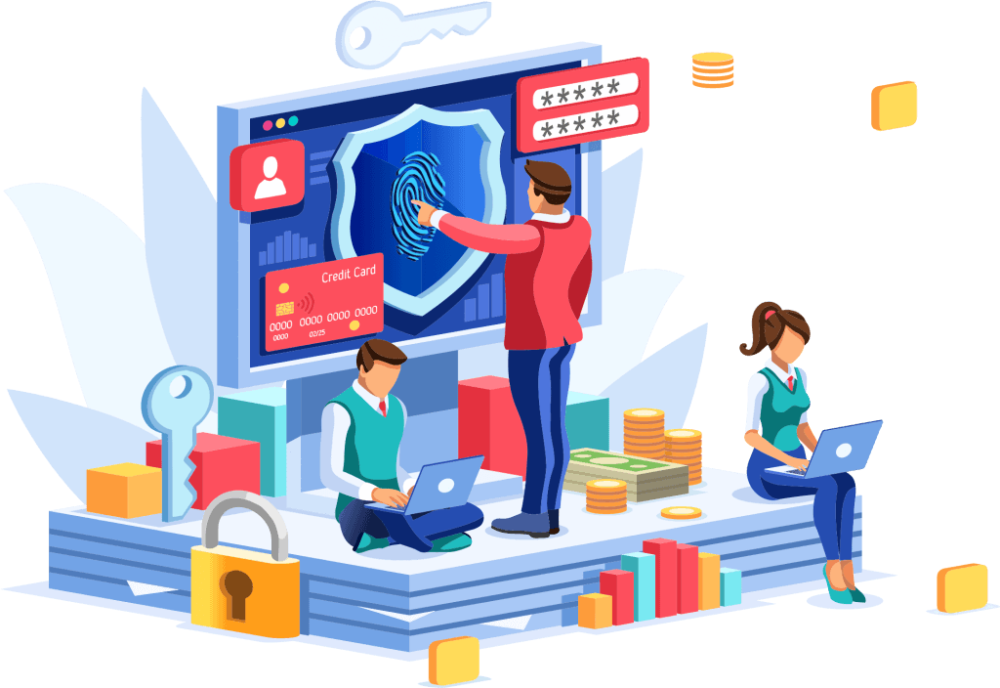
Why Cyber Security Is Important
Cybersecurity is incredibly important for individuals, businesses, and even governments in today's digital world
Our business run over internet after covid-19 online business growing-up
More technologies comes with more risk form cyber attackers. Hackers perform unauthorized hacking into you IT Infra for personal gain
Example: - Gaining access using SSH / FTP protocol
- Gaining access using SMB protocol

Slide 5
What is Ethical Hacking or Penetration tester
Ethical hacking and penetration testing are both terms used to describe the practice of simulating cyberattacks on a system to find vulnerabilities and weaknesses.
Hacker find vulnerabilties or loophole into you IT infrastructre and report all issue in detail report writing
Example: - Detail VAPT Report
Ethical Hacker / Penetration Tester perform VAPT on IT enviroment or physical enviroment to secure organization from cyber attacks
Many organization run bug-bounty programs (bugcrowd, hackerone...etc.)

Slide 6
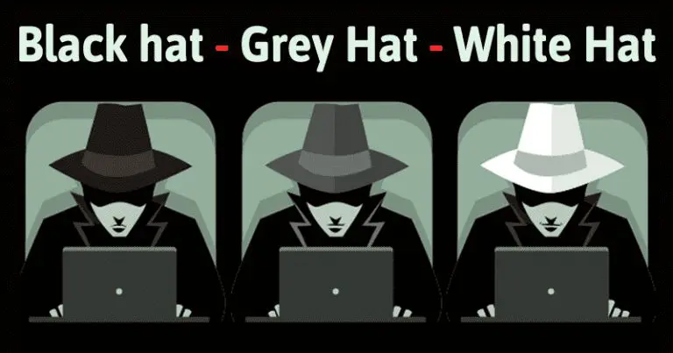
Types Of Hackers
White Hat Hackers: Ethical hackers or penetration tester who use their skills to identify and fix vulnerabilities in systems and networks before malicious actors can exploit them.
Black Hat Hackers: Engage in activities like cybercrime, identity theft, data breaches, and cyberterrorism.
Grey Hat Hackers: May hack into systems to demonstrate vulnerabilities but then disclose them responsibly.
Script Kiddies: Beginners who use readily available tools and scripts to launch basic attacks.
Hacktivists: Use their skills to promote political or social agendas.
State-sponsored Hackers: Work for governments to carry out cyberattacks against other countries or organizations.

Slide 7
Types Of Infrastructure Attacker Attack On Organisations

Slide 8
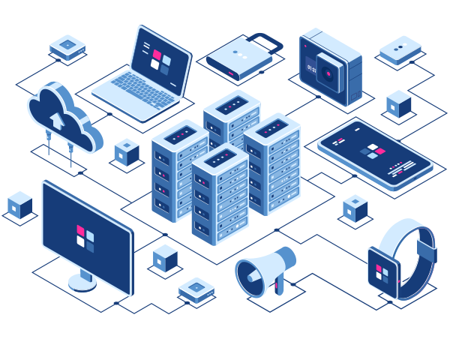
Types Of IT Enviroment
Systems ----> devices ----> PC/Laptops/Mobiles
Networks (wired/wireless ---> Routers,Switch,Protocols,Firewalls,..etc.
Web Applications
Mobile Applications
Desktop Applications
API
Cloud
Hardware / Softwares
Social Engineering ----> physical harm

Slide 9
Ethical Hacking Phases & Cyber Security Teams

Slide 10
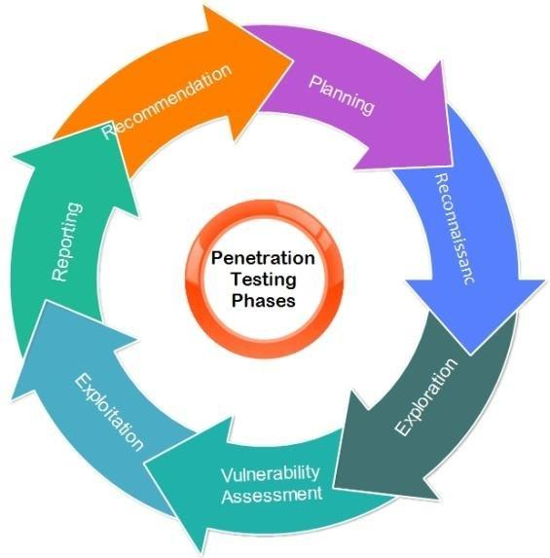
Hacking Phases

Slide 11
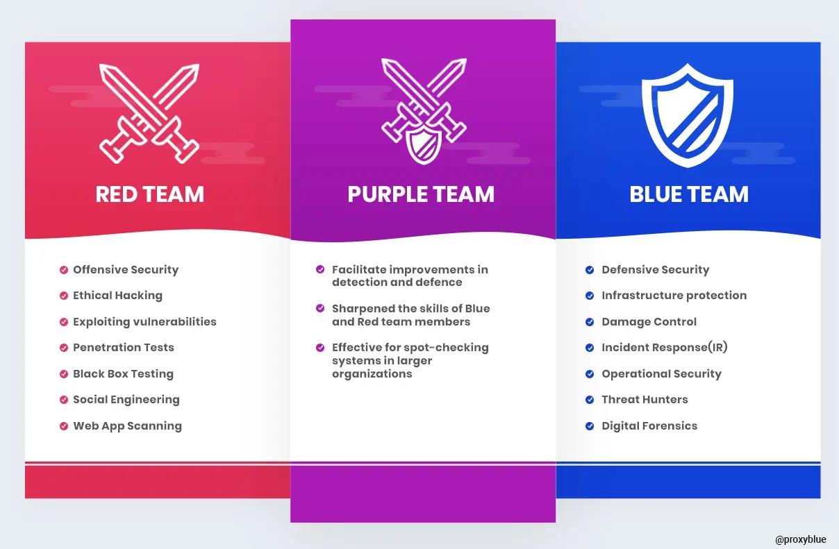
Cyber Security Teams

Slide 12
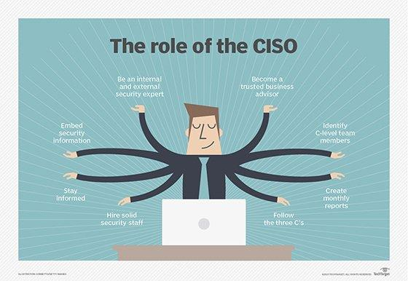
Cyber Security Roles And Responsibilities
Security Analyst / Jr Penetration Tester / Sr Penetration Tester
SOC Analyst
DevSecOps
Incident Response Team
CISO
Digital Forensics

Slide 13
CIA Triad & Cyber Kill Chaining & Cyber Security Regulations

Slide 14
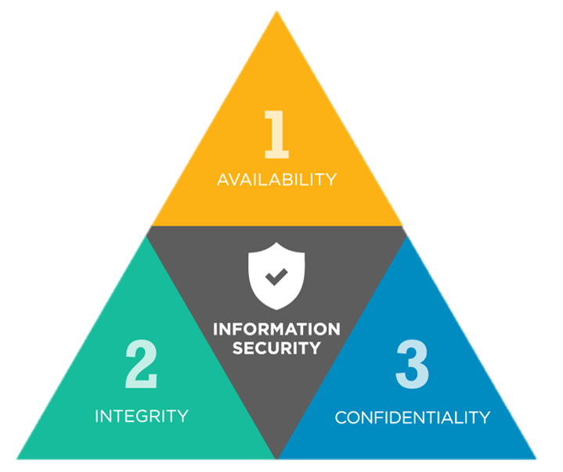
CIA Triad
The CIA Triad, in the realm of cybersecurity, refers to a fundamental model that emphasizes three core principles for robust information security: Confidentiality, Integrity, and Availability (CIA). It serves as a foundational framework for organizations to build their security posture and develop effective policies and controls.
Confidentiality
Intigrity
Availability

Slide 15
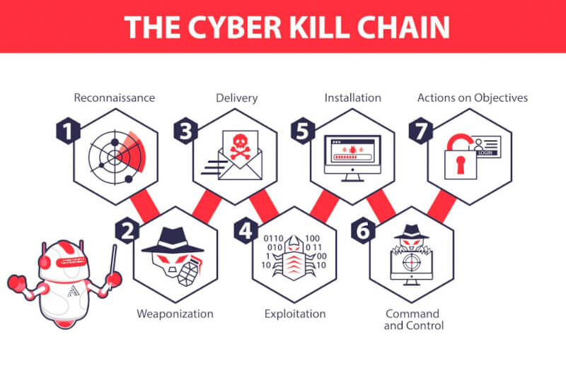
Cyber Kill Chaining
Cyber kill chaining is a powerful framework used in cybersecurity to understand and disrupt the steps attackers take to compromise a system.
Example:
- System Hacking using malicious payload

Slide 16
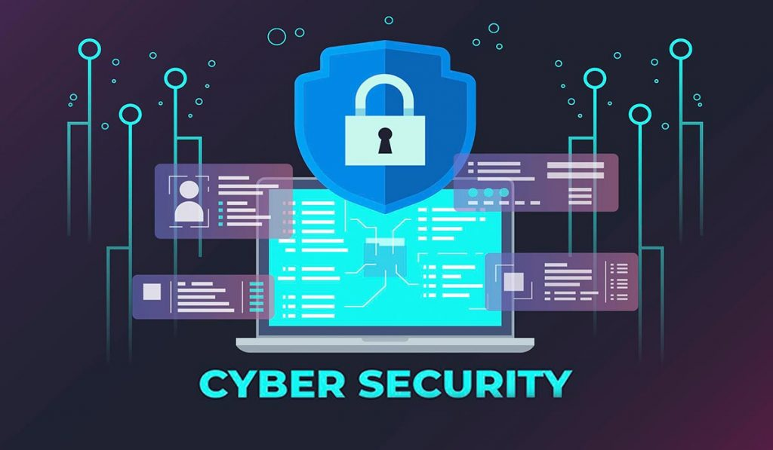
Cyber Security Regulations
General Data Protection Regulation (GDPR): Protects the personal data of individuals (EU citizens and residents) .
Health Insurance Portability and Accountability Act (HIPAA): Protects the privacy and security of individually identifiable health information (protected health information or PHI)
Payment Card Industry Data Security Standard (PCI DSS): Protects cardholder data (e.g., credit card numbers, expiration dates)

Slide 17
Types Of Network Attacks

Slide 18
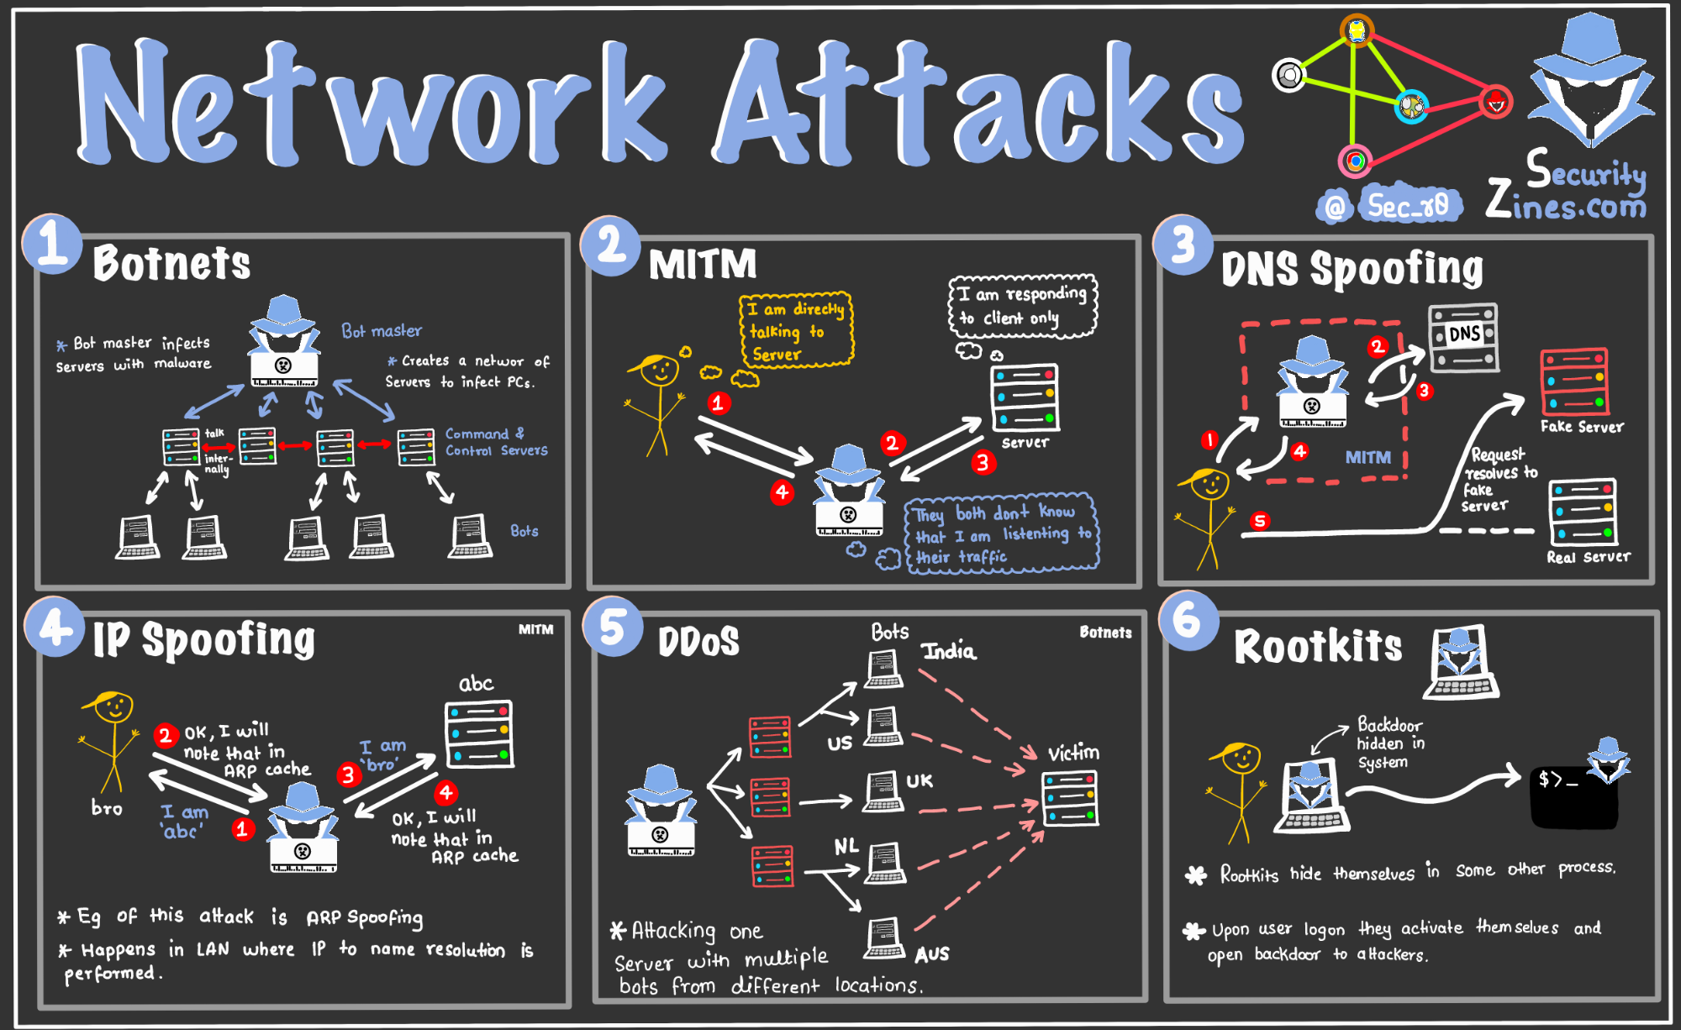
Types Of Network Attacks
Denial-of-Service (DoS) Attacks
Distributed Denial-of-Service (DDoS) Attacks
Man-in-the-Middle (MitM) Attacks
DNS Spoofing
Rootkits
Zero-Day Attacks
Password Attacks

Slide 19
Types Of Web-Application Attacks

Slide 20
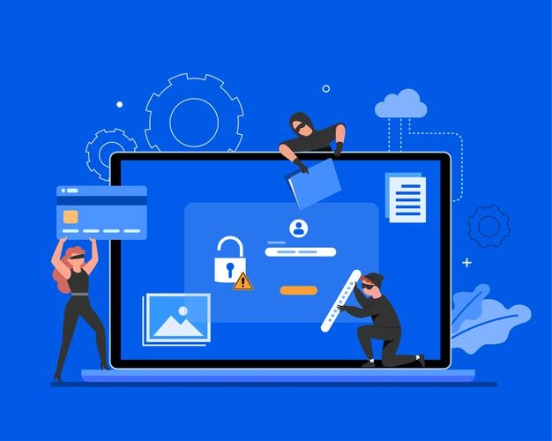
Types Of Web-Application Attacks
SQL Injection
XSS Injection
Comand Injection
Broken Authentication
Brute Forcing
IDOR
Parameter Tempring
Security Misconfiguration
ClickJacking
CSRF
MITM
Dos Attack

Slide 21
Types Of Mobile-Application Attacks

Slide 22
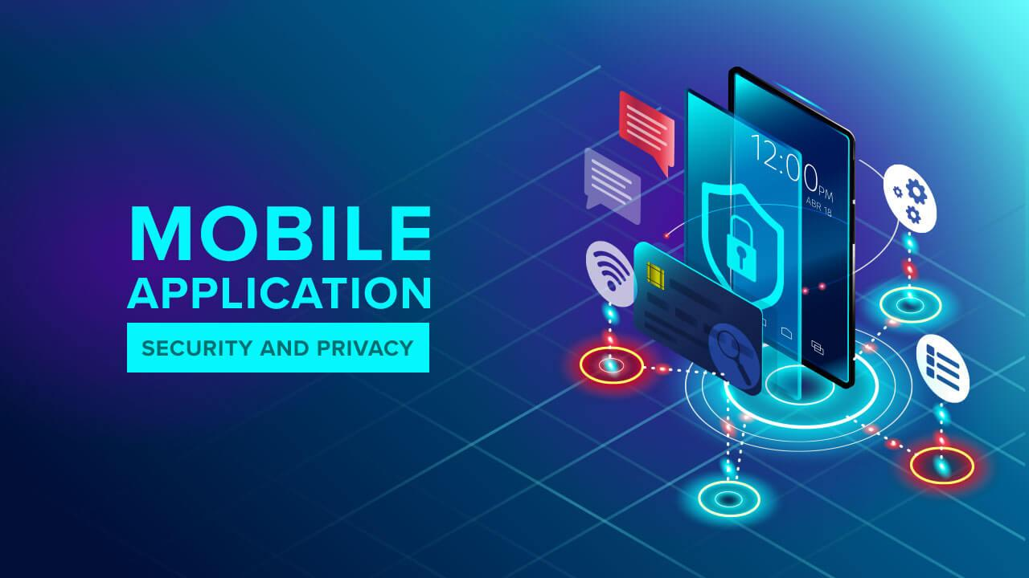
Types Of Mobile-Application Attacks
Insecure Logging
Insecure Data Storage
SQl Injections
Input Validation
Access controls
Broken Authentcation
Weak Cryptography
Security Misconfiguration
Reverse-Engineering
Dos Attack

Slide 23
Social Engineering & Physical Attack

Slide 24
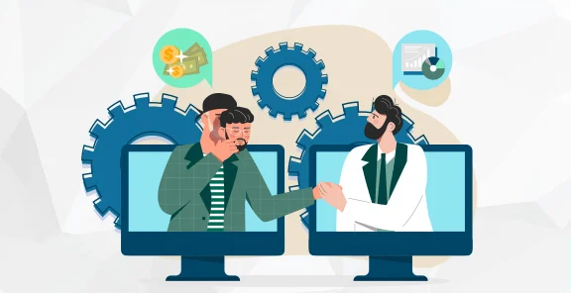
Social Engineering & Physical Attacks
Phishing Attack
Pretexting Attack
Malware,Ransomeware and Viruses Attack
Tailgating
Piggybacking
Shoulder Surfing
Offering money or other valuables in exchange for access or information.

Slide 25
Q & A

